Slide 1
RA-ISF: Learning to Answer and Understand from Retrieval Augmentation via Iterative Self-Feedback
任务：Query Text → LLM → Answer Text
问题：
（1）检索结果中包含了不相关的知识削弱了模型解决问题的能力
（2）结合LLM参数化的知识和检索的知识存在困难

Slide 2
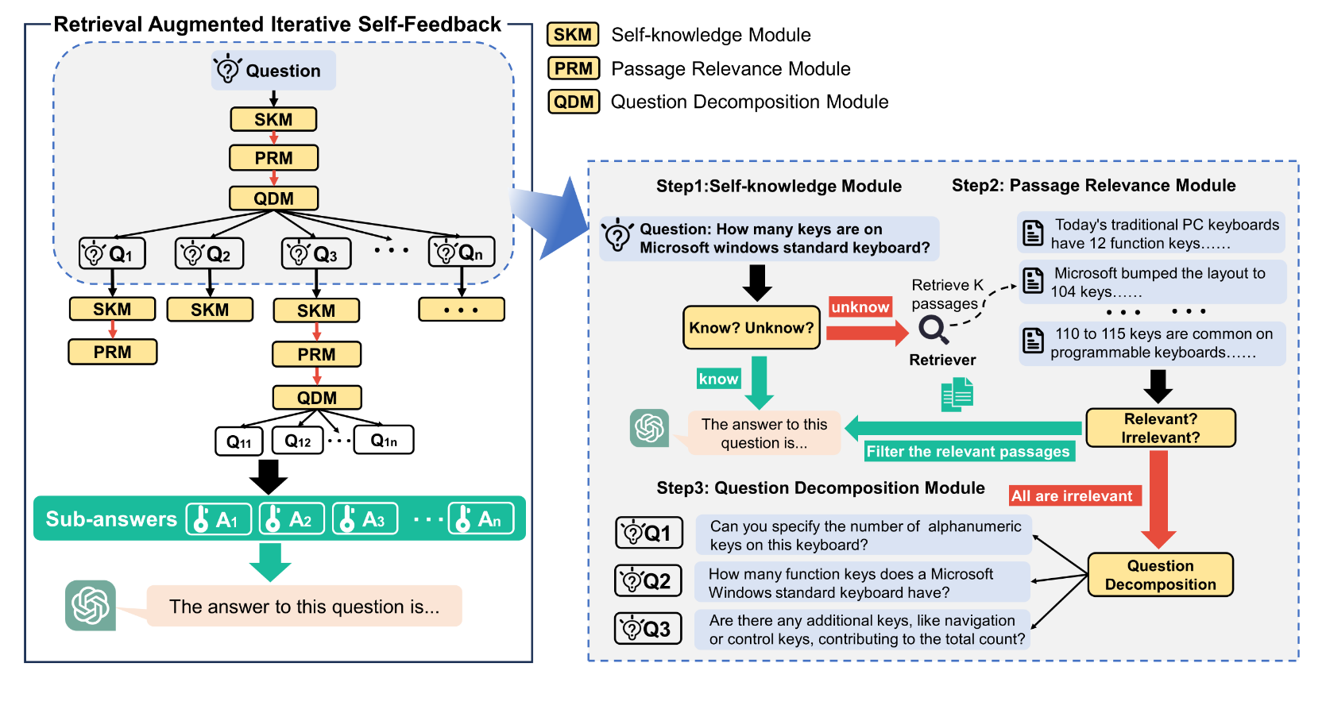
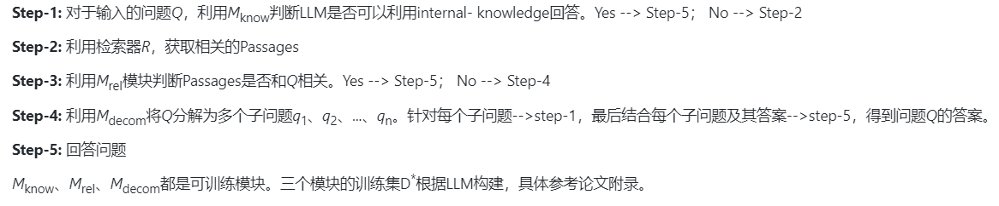
RA-ISF: Learning to Answer and Understand from Retrieval Augmentation via Iterative Self-Feedback
模型：

Slide 3
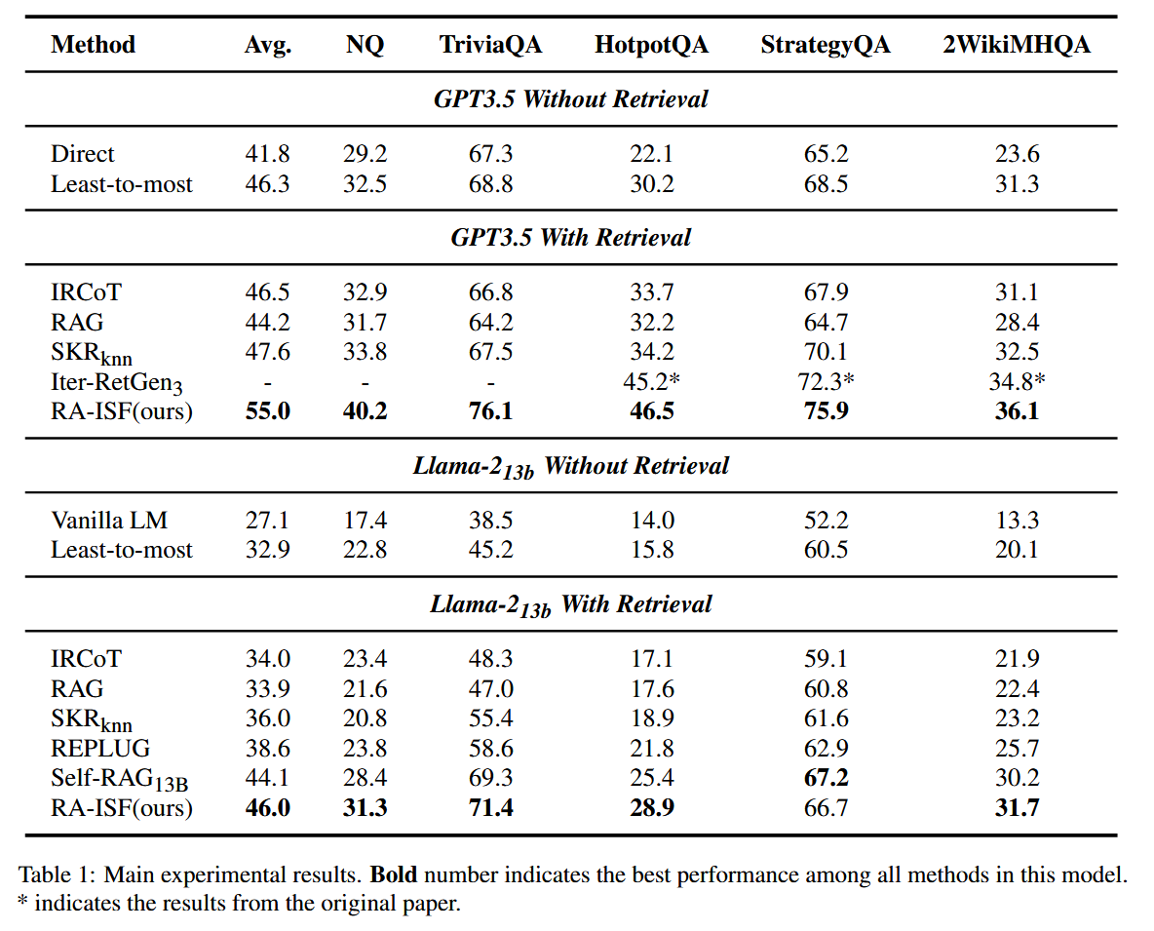
RA-ISF: Learning to Answer and Understand from Retrieval Augmentation via Iterative Self-Feedback

Slide 4
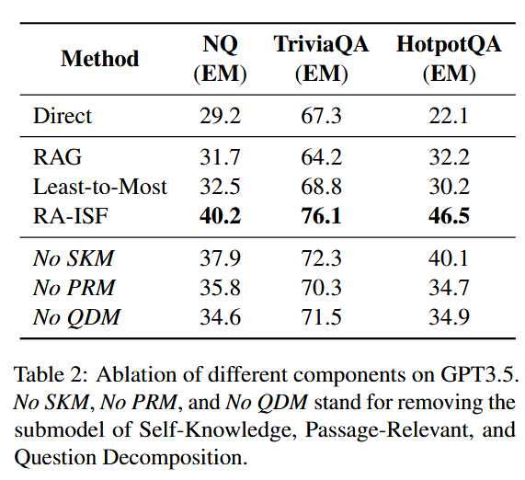
RA-ISF: Learning to Answer and Understand from Retrieval Augmentation via Iterative Self-Feedback

